Slide 1


Team 26: Voice-Controlled Robot
Bi-Weekly Update 1 Logan Cardwell, Dawson Holly,
Nicholas McCray, Cameron Schoenfeld Sponsor: Zhewen Hu TA: Zhewen Hu
Notes:
Logan

Slide 2
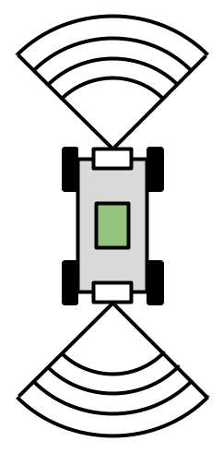
Project Summary
We are creating a simple robot that can be modified and adapted for use in various situations, primarily as robotic food runners in restaurants and similar environments.
The robot is able to take in voice commands and manual control from a mobile application to direct its movement while sensors detect and prevent imminent collisions.
Notes:
Logan

Slide 3
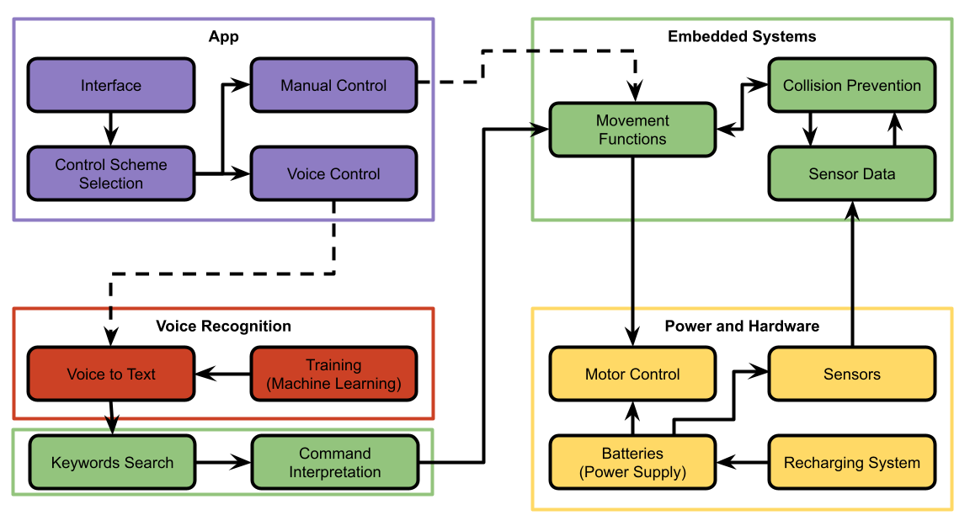
Project/Subsystem Overview
Voice Recognition: Outputs text transcription from received audio file.
Power and Hardware: Provides the required power for the motor driver and the raspberry pi.
App Design:
Receive manual and audio commands to transmit to the robot.
Embedded Systems:
Underlying logic and data flow between all other subsystems.
Logan Cardwell Dawson Holly Nicholas McCray Cameron Schoenfeld
Notes:
Dawson

Slide 4
Major Project Changes for 404
Team membership has remained consistent after the transition from 403 to 404.
Leadership of the physical building of the robot has been assigned to Dawson Holly due to his close work with the circuits, power, and motors.
So far, the transition has been largely seamless and without issue from 403 to 404.
Notes:
Nick

Slide 5
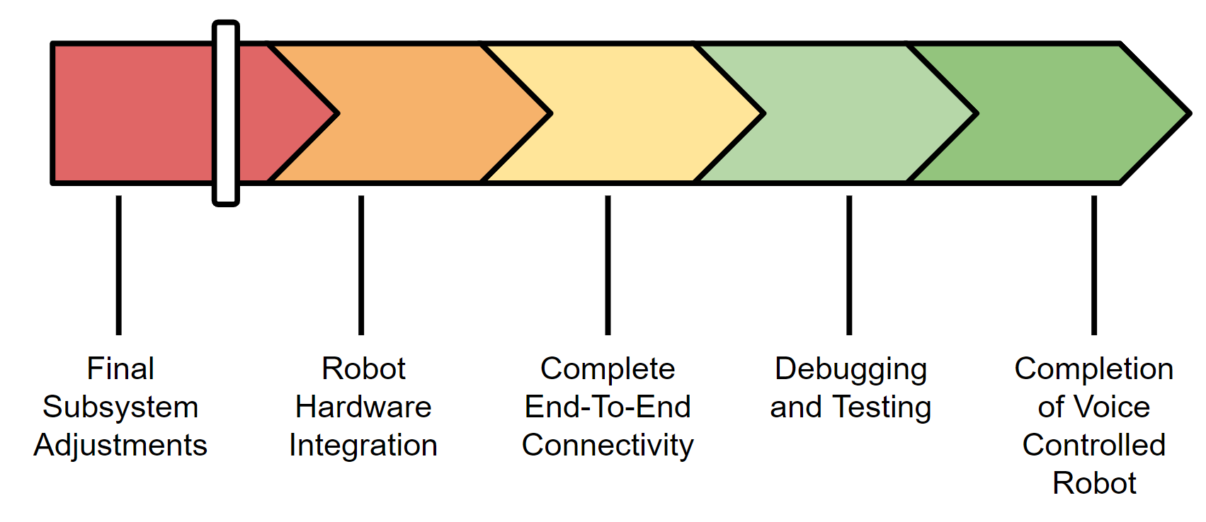
Project Timeline
Notes:
Cameron

Slide 6
Voice Recognition
Logan Cardwell
Accomplishments since 403 7 hrs of effort | Ongoing progress/problems and plans until the next presentation
Approximately 40 minutes of additional command audio has been generated or recorded. | Additional command audio will be fed into ML model. 2000-3000 takes from Mozilla’s Common voice data set to allow the TTS model to recognize mis-inputs.
Notes:
Logan

Slide 7
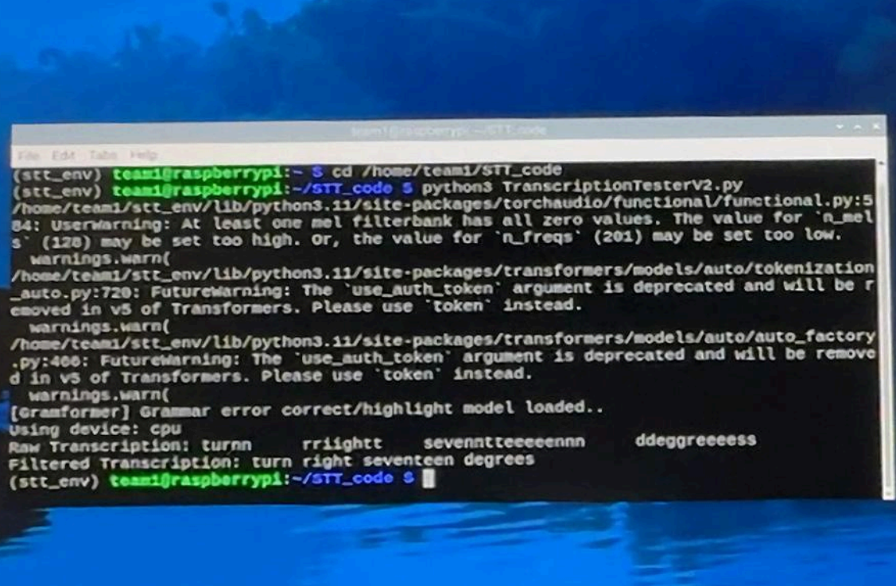
Voice Recognition
Logan Cardwell
New data set will provide context for incorrect commands. The current data set only accommodates valid commands
Current data set occasionally struggles with numbers over 100, more voice lines will help with this
Notes:
Logan

Slide 8
Power & Hardware
Dawson Holly
Accomplishments since 403 17 hrs of effort | Ongoing progress/problems and plans until the next presentation
New motor driver board has been designed and ordered. Board has been soldered and is waiting to be tested on 9/05/24. | Test PCB. Integrate all components into the circuit. Design physical sub frame for robot. Determine the load of the fully functional circuit.
Notes:
Dawson

Slide 9
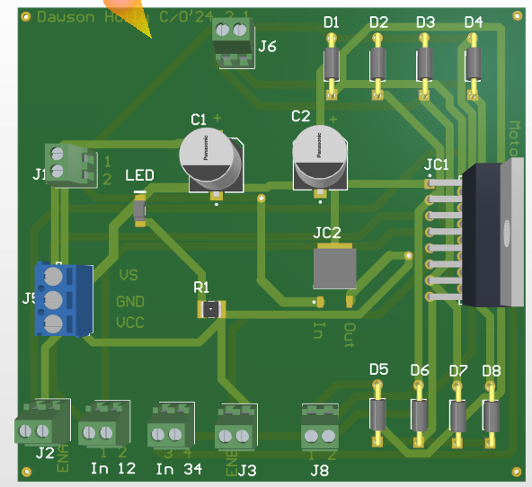
Power & Hardware
Dawson Holly
New Motor Controller Design
Old driver did not provide sufficient power
to motors.
New driver will provide 10.5V to motors.
Implements block instead of pin connectors.
Each motor output will be capable of 3.5A.
Increased circuit voltage from 2 batteries to 3.
Notes:
Dawson

Slide 10
App Design
Nicholas McCray
Accomplishments since 403 8 hrs of effort | Ongoing progress/problems and plans until the next presentation
 | Verify app integrity from 403. Connect app to Rasp Pi via Bluetooth.
Notes:
Nick

Slide 11
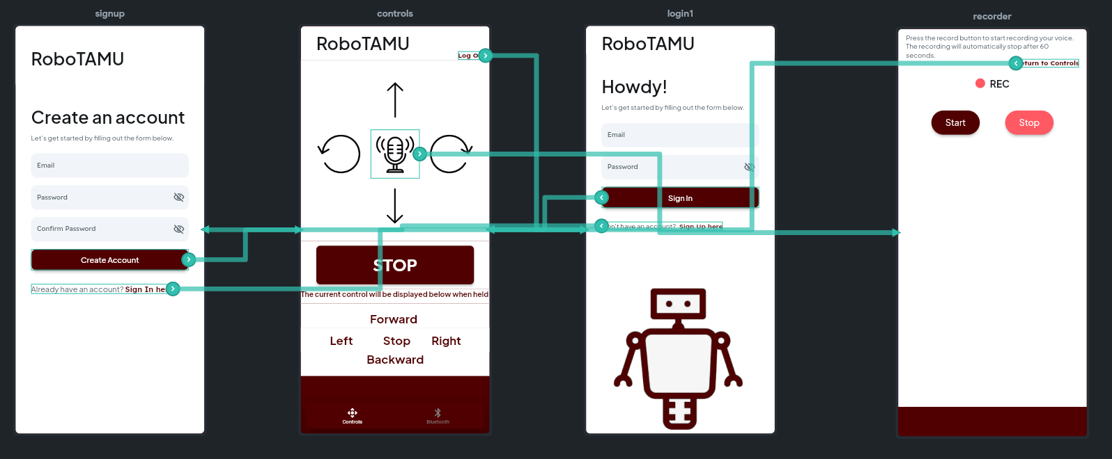
App Design
Nicholas McCray
Notes:
Nick

Slide 12
Embedded Systems
Cameron Schoenfeld
Accomplishments since 403 8 hrs of effort | Ongoing progress/problems and plans until the next presentation
Completed testing of all functionalities with a large variety of inputs to ensure all function continue to work as intended. | Finalize file types that will be used to pass data between subsystems. (App & Voice Recognition) Connect to both the App and Voice Recognition software.
Notes:
Cameron

Slide 13
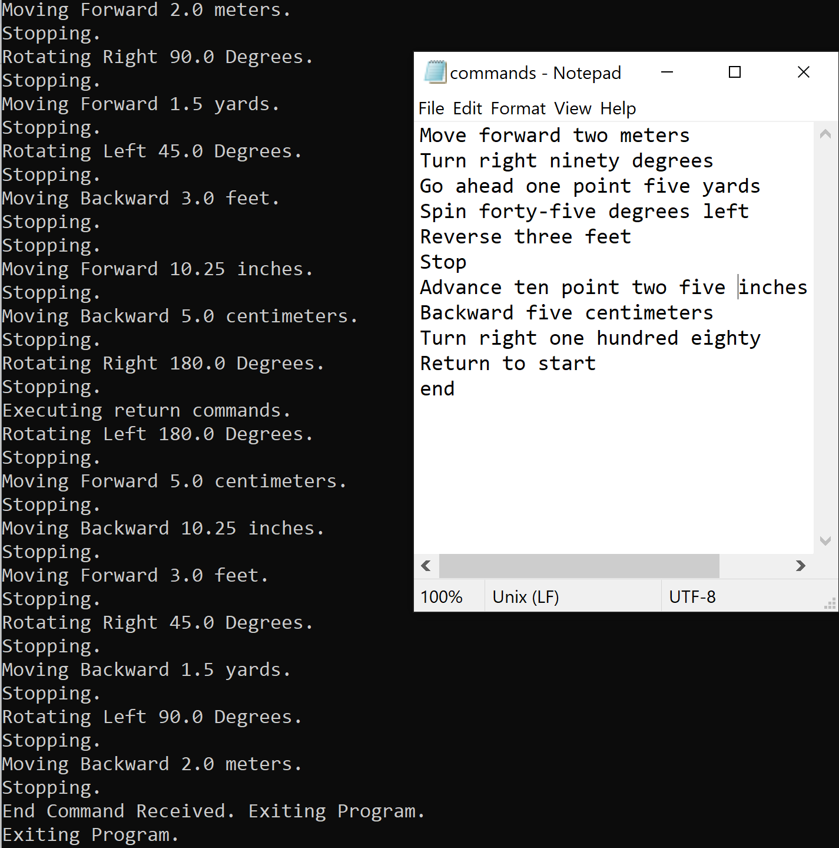
Embedded Systems
Cameron Schoenfeld
Can currently translate written words up to 1000 with up to 2 decimal places.
Can understand various units of measurement.
Accepts various keywords to perform movement functions.
Notes:
Cameron

Slide 14
Parts Ordering Status
Raspberry Pi fan has been ordered, it is arriving on September 9th.
Notes:
Logan

Slide 15
Execution Plan
 |  | 8/19 | 8/26 | 9/2 | 9/9 | 9/16 | 9/23 | 9/30 | 10/7 | 10/14 | 10/21 | 10/28 | 11/4 | 11/11 | 11/18 | 11/25 | 12/2
Test New Motor Driver PCB | Dawson Holly
TTS Invalid Command Recognition | Logan Cardwell |  |  |  |  |  |  |  |  |  |  |  |  |  | Not Started
Integrate Hardware to Robot Structure | Dawson Holly |  |  |  |  |  |  |  |  |  |  |  |  |  | In Progress
App Connection to Raspberry Pi | Nicholas McCray |  |  |  |  |  |  |  |  |  |  |  |  |  | Completed
Motor Control and Calibration with Embedded Systems | Cameron Schoenfeld |  |  |  |  |  |  |  |  |  |  |  |  |  | Behind Schedule
Sensor Calibration with Embedded Systems | Cameron Schoenfeld
App Data Transmission and Receiving | Nicholas McCray, Cameron Schoenfeld
Voice Recognition Data Transmission and Receiving | Logan Cardwell, Nicholas McCray, Cameron Schoenfeld
Total Project Debugging | Whole Team
Notes:
Cameron

Slide 16
Thank You
Notes:
Cameron

